Slide 1


Slide 2
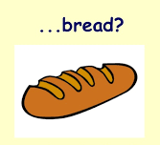


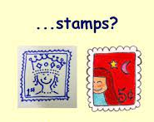



Slide 3
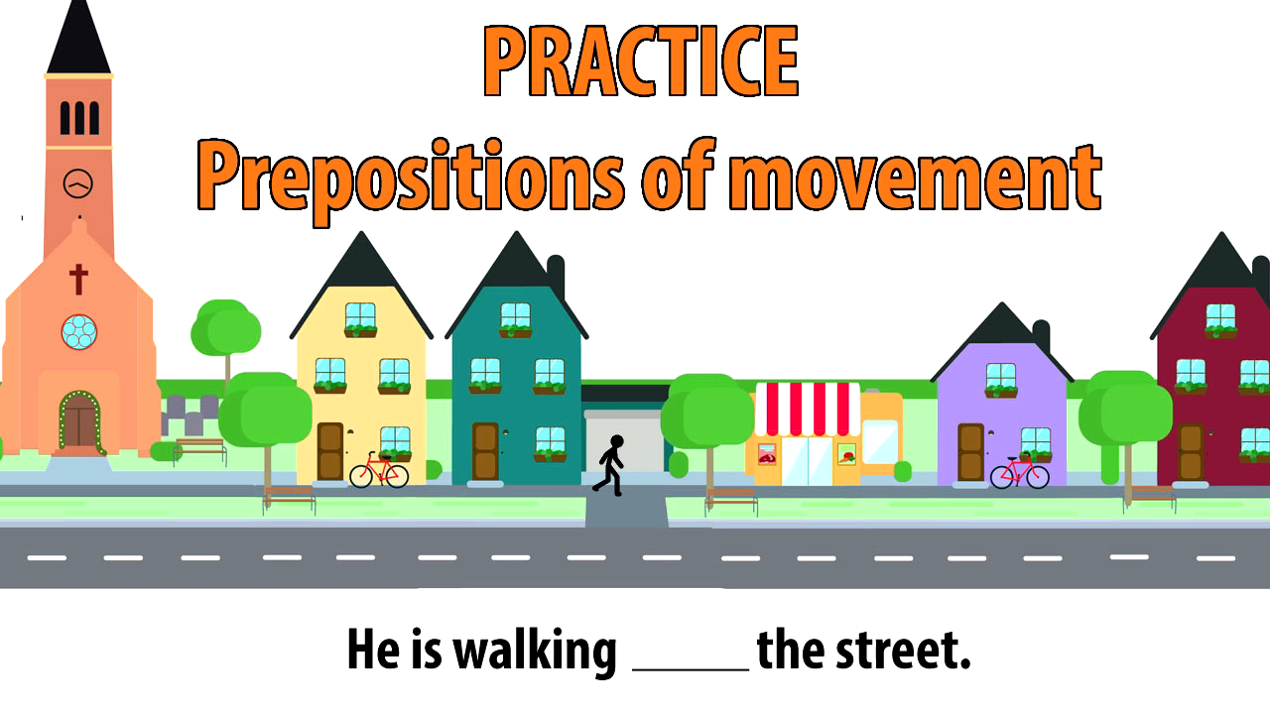

Slide 4
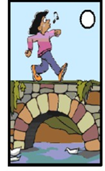
The girl is walking _________ the bridge.
over

Slide 5
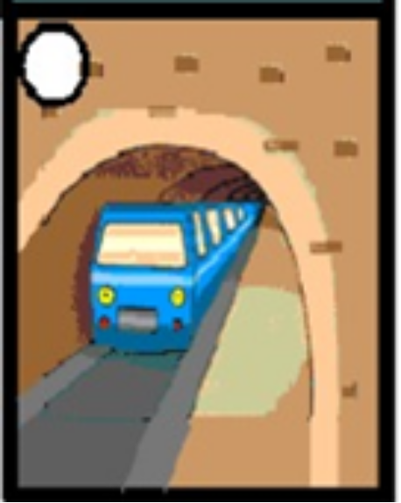
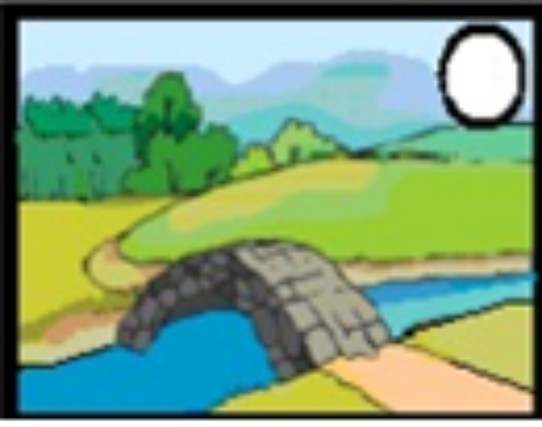
The train came _________ the tunnel.
through
over
The bridge is ____________ the river.

Slide 6
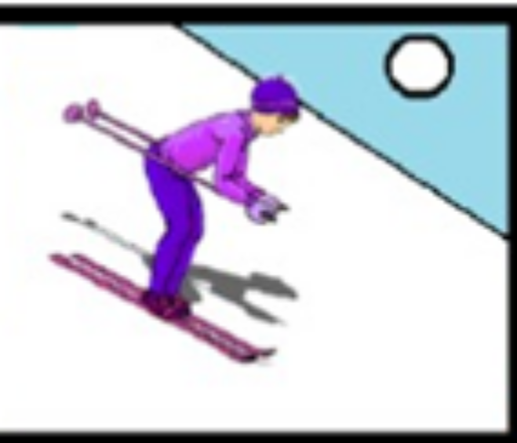
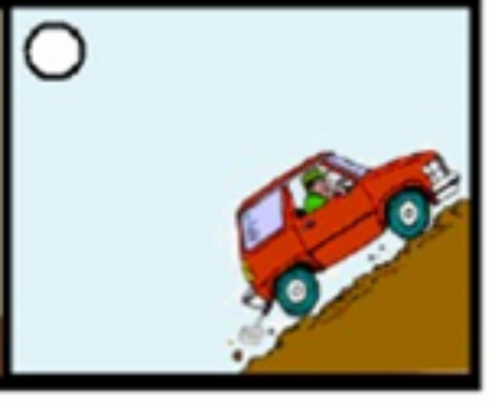
down
The woman is skiing ______________ the mountain.
up
The car is driving ____________ the hill.

Slide 7
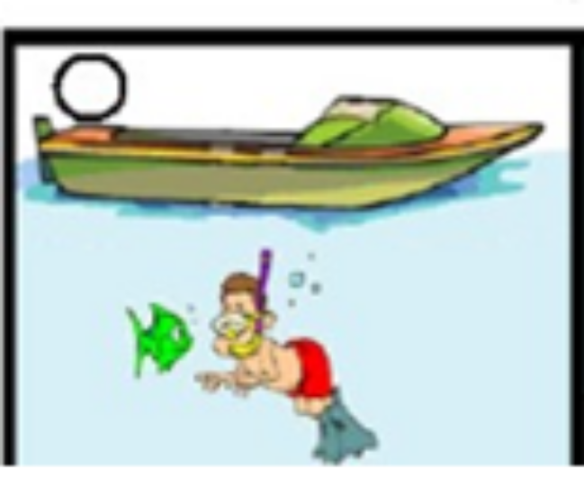
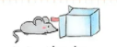
under
The man is swimming ___________ the boat.
into
The mouse is running ___________ the box.

Slide 8
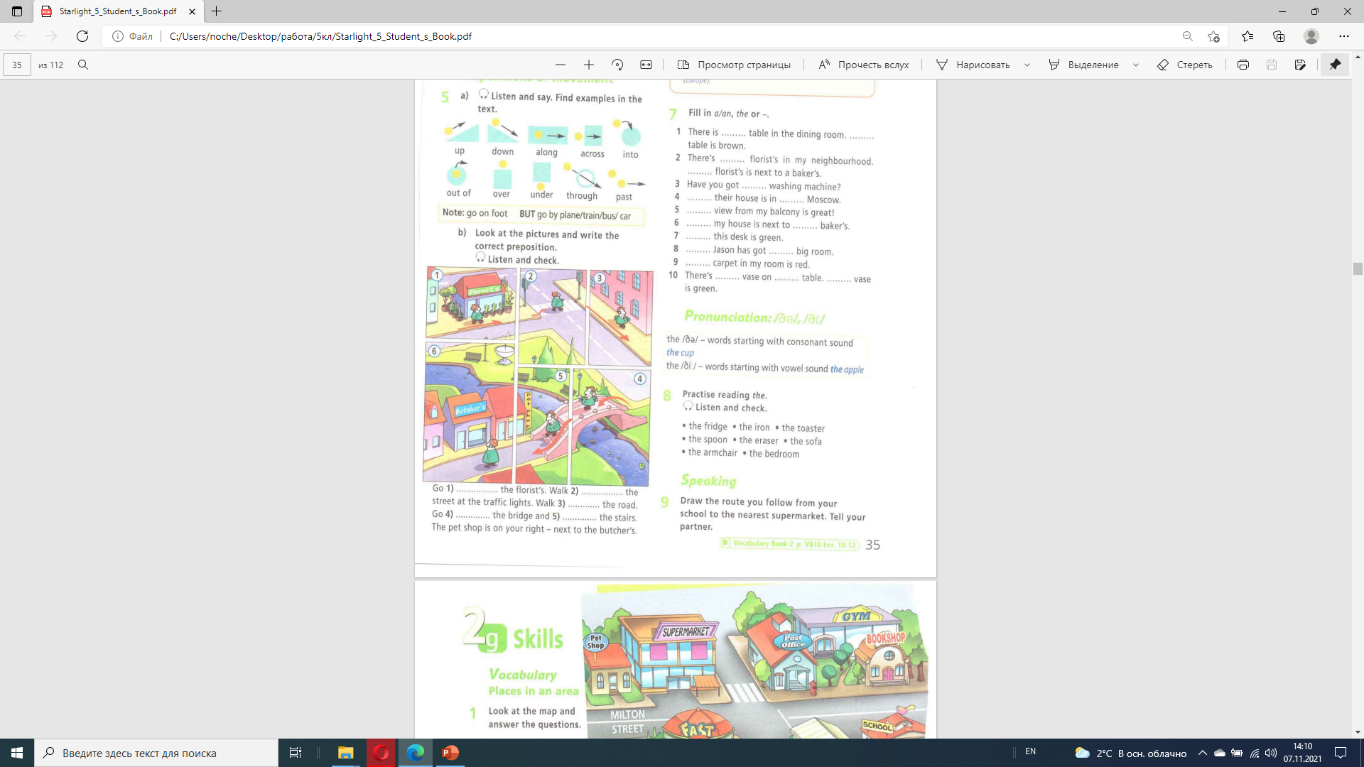

past
across
along
over
down

